Slide 1
Title: Atlassian Bamboo
Authored and Presented by: Prakash Bayas

Slide 2
Agenda
Continuous Integration Basics
Bamboo Concepts
Advantages
Version 5.6 Features

Slide 3
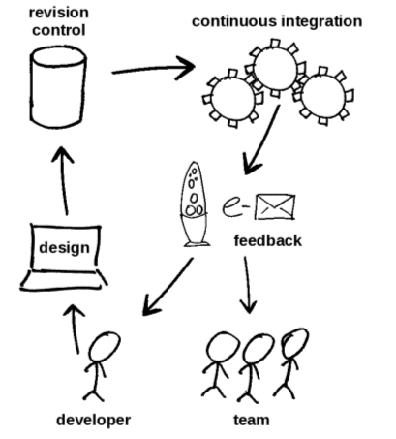




Continuous Integration Basics
Author writes programs.
And, commits to a source code repository.
This commit triggers jobs onto continuous integration server.
It, then, notifies status of compilation, testing, code coverage, archiving and deployment as a feedback.
Development team acts upon this feedback.
Continuous Integration Servers

Slide 4
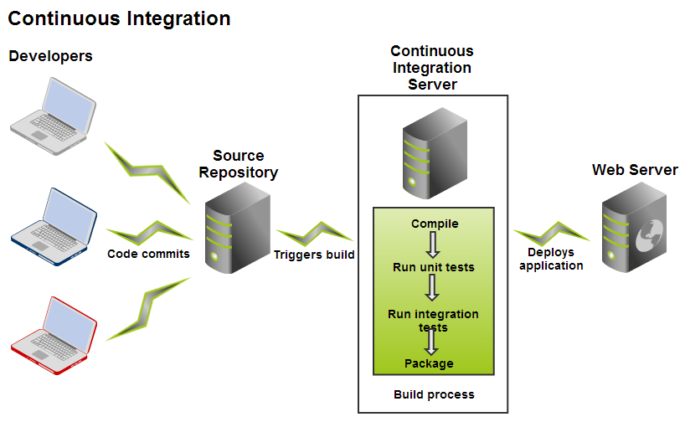
Bamboo Concepts
Bamboo is a continuous integration server.
It builds project and runs test suite after developer commits an update.
It offers build telemetry to provide insight into trends across builds.
Ant
Maven 1
Maven 2
Script
Pluggable
CVS
Subversion
Perforce
Pluggable

Slide 5
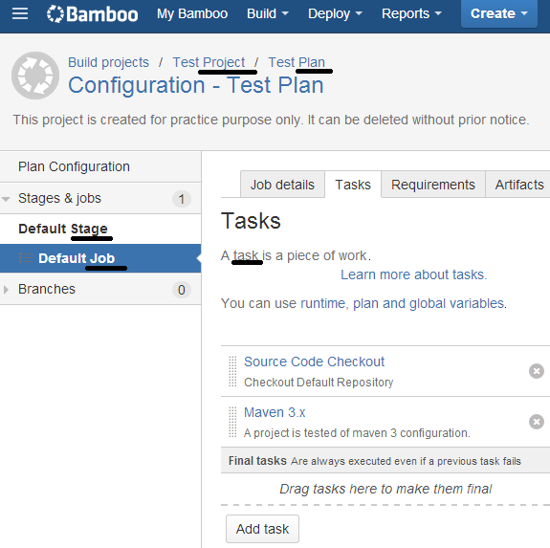
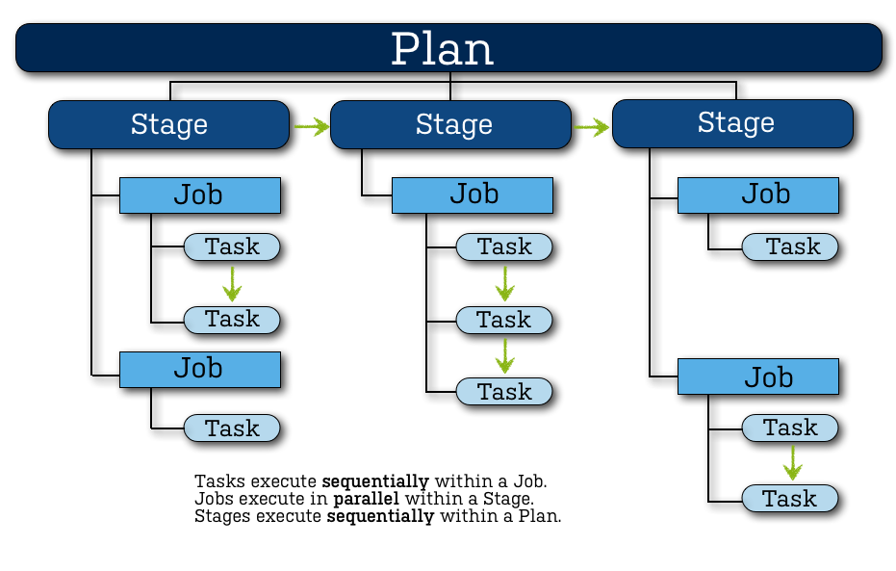
Bamboo Concepts
Bamboo server associates a project with a plan.
A plan has stages of jobs .
Tasks runs sequentially within a job.

Slide 6
Advantages
Increases traceability of defects
Increases visibility of progress
Early feedback from end users
Allows for staged, or partial, delivery
Reduces risk of major rework, and project slippage or failure
Build Telemetry
“See the forest for the trees”
Not just about statistics - it’s about intelligently highlighting linkages in build information to identify insights about your project.
Collaboration
Comment on your builds - why did this break? what happened here?
Label your builds - tagging is a good way to quickly identify certain builds (and allows searching)
Integration
JIRA integration
IDE integration
Fisheye integration

Slide 7
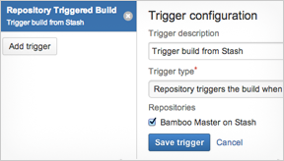
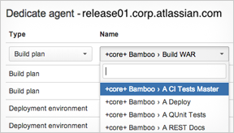
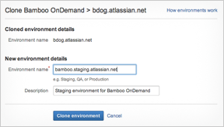
Version 5.6 Features
Repo-driven triggers via Stash
Stash can now call out and trigger builds in Bamboo as soon as a change has been pushed to a repo. No polling. No webhooks. No special repository configurations required. And with the new bulk action to edit triggers en masse, lighter load for your CI system is a click (ok: maybe two clicks) away.
Dedicated agents
Ever been stalled by a critical build that got buried in the queue? Or frustrated when the hardware you paid for is running someone else's job? We've solved both problems by letting you make any agent dedicated to specific projects, plans, and jobs on the CI side, or specific projects and environments on the deployments side.
Repo-driven triggers via Stash
Stash can now call out and trigger builds in Bamboo as soon as a change has been pushed to a repo. No polling. No webhooks. No special repository configurations required. And with the new bulk action to edit triggers en masse, lighter load for your CI system is a click (ok: maybe two clicks) away.

Slide 8

Any Questions?

Slide 9
Thank You!

